Slide 1
Spectroscopy
Laboratory 1
Protonation of water

Slide 2
Raman spectroscopy

Slide 3
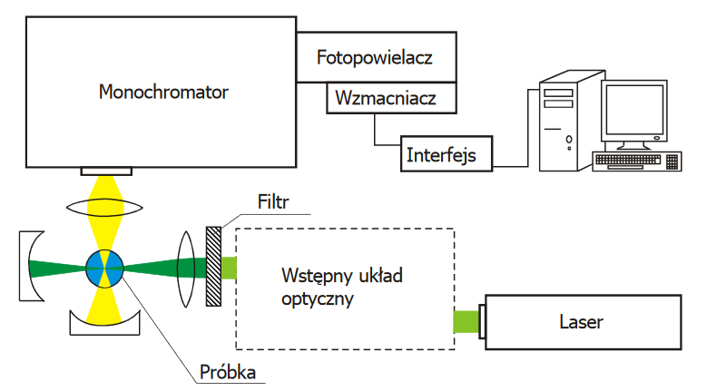
Raman spectrometer
Photomultiplier
Amplifier
Interface
Filter
preliminary optical system
Sample

Slide 4
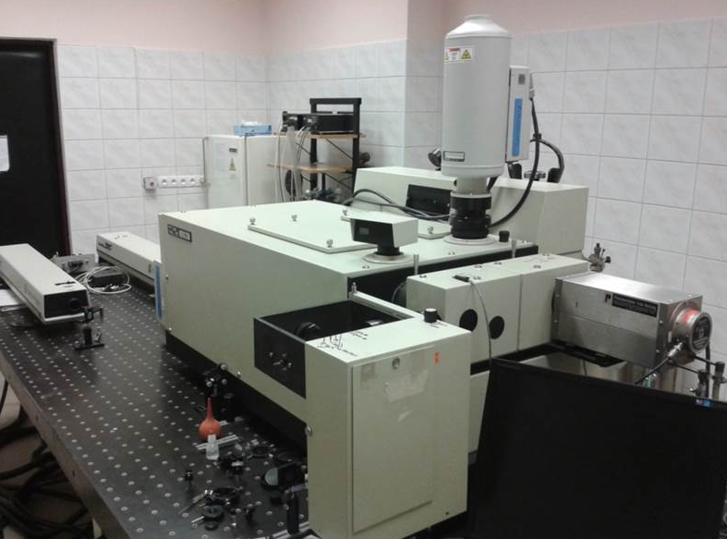

Slide 5
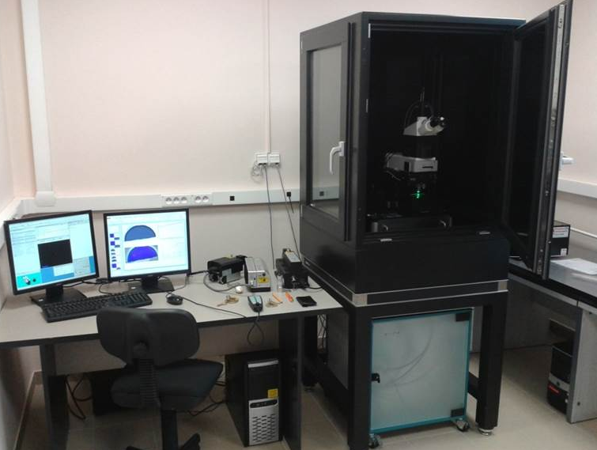
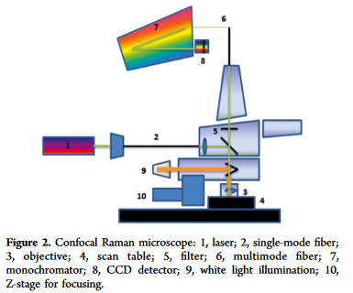

Slide 6
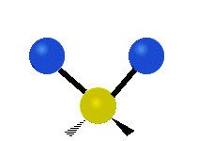
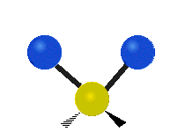
Non-linear moleule 3n-6 normal vibrations
Linear molecule 3n-5 normal vibrations
Symmetrical stretching
Asymmetrical stretching
Scissoring (Bending)
Wagging
Twisting
Rocking

Slide 7
The aims of the exercise are to :
measure the vibrational spectra of water by Raman spectroscopy
calculate the frequency of vibrations by quantum-mechanical methods using the HyperChem program.
Determine the theoretical value of the protonation Energy
determine the type, symmetry of vibrations and the theoretical values of the frequency of vibrations of the water, hydronium ion
The comparison of the experimental and theoretical methods for determining the vibrational properties of water allows to determine the type and symmetry of vibrations, and the analysis of divergence allows to draw conclusions about additional effects that occur in the water.
Determination of the theoretical value of the protonation energy and comparison with the experimental value allows to draw conclusions about the nature of the above-mentioned interactions.

Slide 8
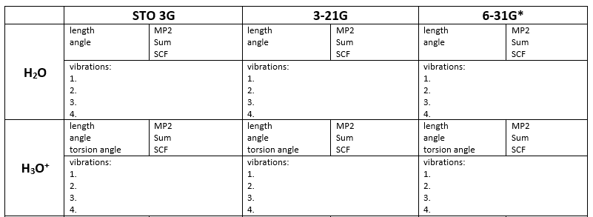
draw a molecule H₂O or H₃O⁺(possibly add a charge)
select a database
optimize particle geometry (read bond length, angle and torsion angle)
calculate the total energy of the particle (total and MP2)
determine vibrational properties of a molecule (frequency and type of vibration)
determine the protonation Energy [Esum H₃O⁺ - Esum H₂O]

Slide 9
Report:
theoretical introduction (1-1.5 pages) (aim of the exercise, description of Raman spectroscopy, description of the Raman spectrometer)
calculated results
designated protonation energy
Raman spectrum of water
Conclusions:
comparison of theoretical calculations with experimental results (bond lengths, value of angles, protonation energy) and comparison of results from three databases
Why are there deviations in the theoretical and experimental values - what interactions we did not take into account when modeling our molecules by computer?
At which base does the protonation energy come closest to the true one? What are the possible reasons for the deviation of the theoretically calculated energy from the experimentally calculated one?

Slide 10
Spectroscopy
Laboratory 2
Polarization

Slide 11
Depolarization ratio
Raman bands depolarization ratios are used to determine symmetry of Raman vibrations, and thus to name / define them.
z
ρ - depolarization ratio
ρ = $\frac{I_{y}(I_{⊥}) }{I_{z}(I_{∥}) }$
$$I_{z} (I_{∥})$$
y
polarization analyzer
$$I_{y} (I_{⊥})$$
the direction of the incident laser beam
a quarter-wave plate
x
the direction of observation
The quarter-wave plate must be used after the polarization analyzer in the path of light entering the monochromator due to the different sensitivity of the monochromator grids for the $⊥$and ∥ polarized light components.

Slide 12
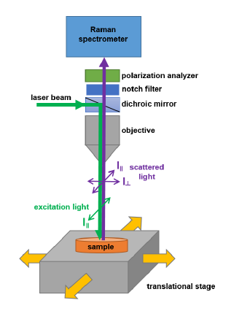

Slide 13
Depolarization ratio (${\text{}}_{p})$ can be calculated:
${\text{}}_{p}$ = $\frac{I_{⊥}(I_{y}) }{I_{∥}(I_{z}) }$
depolarization ratio of a totally symmetric vibrational mode is less than 0.75 0 ${≤\text{ρ}}_{p}<$ $\frac{3}{4}$ (polarized band).
For not-totaly symmetric, $g^{0}$ = 0 i $g^{5}$ > 0, a zatem ${\text{}}_{p}=$ $\frac{3}{4}$ (depolarized band).

Slide 14
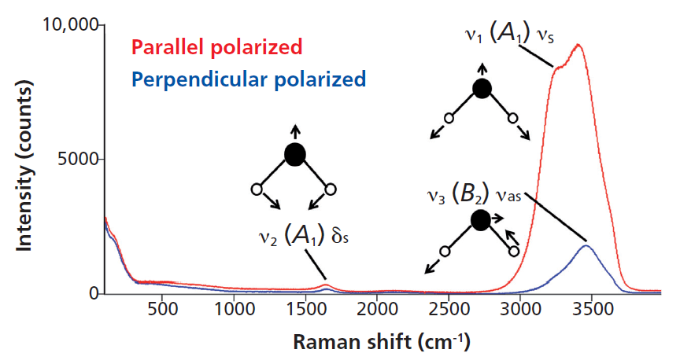
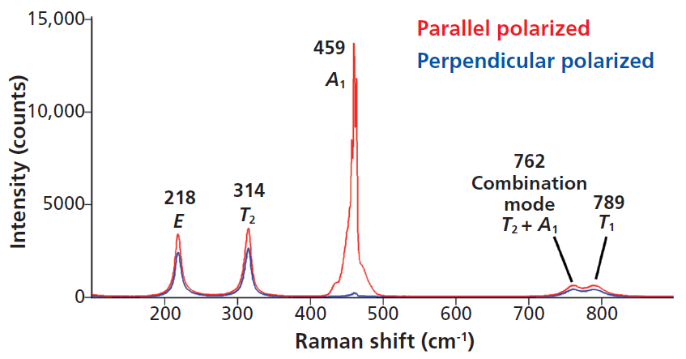
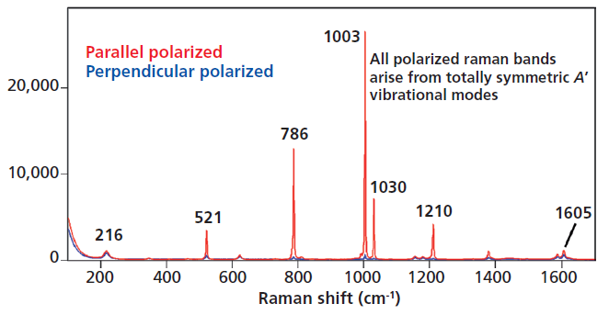
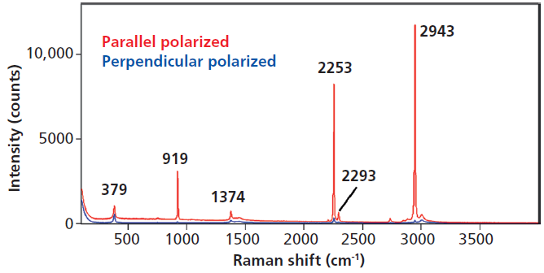
Water
carbon tetrachloride.
toulene
acetonitryle
Spectroscopy 29(3) March 2014

Slide 15
depolarization ratio of a totally symmetric vibrational mode is less than 0.75 0 ${≤\text{ρ}}_{p}<$ $\frac{3}{4}$ (polarized band).
For not-totaly symmetric, $g^{0}$ = 0 i $g^{5}$ > 0, a zatem ${\text{}}_{p}=$ $\frac{3}{4}$ (depolarized band).

Slide 16
Report:
theoretical introduction (1-1.5 pages) (aim of the exercise, description of depolarization ratio, description of the Raman spectrometer)
Measured spectrum of the carbon tetrachloride.
Calculated depolarization ratio for all Raman bands
Conclusions:
comparison of calculations with literature

Slide 17
Spectroscopy
Laboratory 3
Gaussian

Slide 18
O
C
H
H

Slide 19
O
2
B
C
O 1 AB
H 1 AH 2 HAB
H 1 AH 2 HAB 3 180.00
AB: 1.1480
AH: 1.0914
HAB: 122.14
C
1
A
H
H
3
4

Slide 20
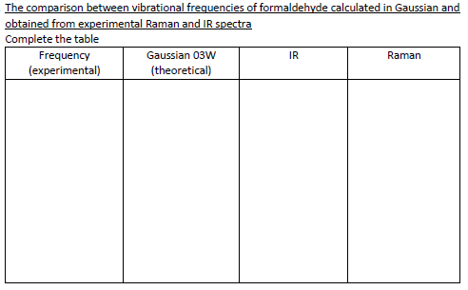
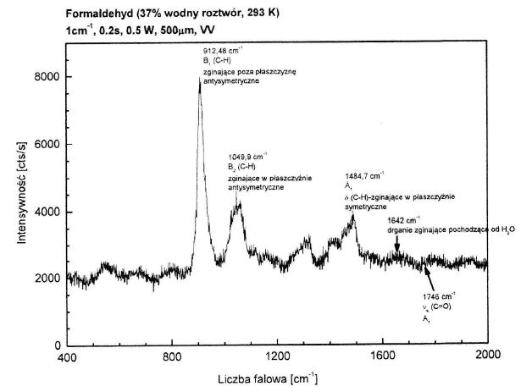
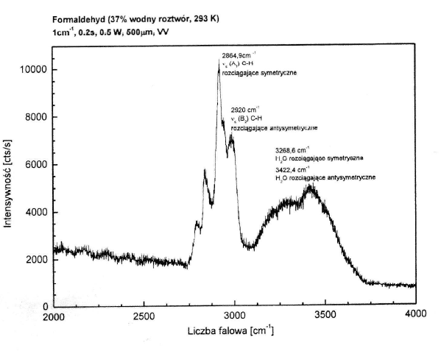

Slide 21
z
O
y
C
H
H
x

Slide 22
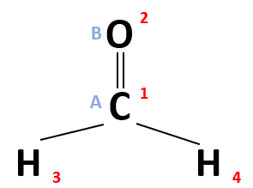
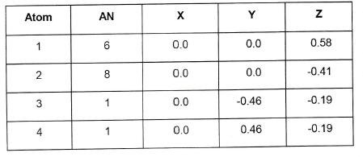
z
O
y
C
H
H
x

Slide 23
z
O
y
C
H
H
x

Slide 24
z
O
y
C
H
H
x
Stretching vibrations of the carbonyl group (C=O) with a minor contribution of bending vibration (H-C-C angle)

Slide 25
Experimental values?

Slide 26
REPORT:
a. Theoretical background
b. Aim and description of the performed excercise
c. Printout of Gaussian output files
d. Printout and interpretation of the experimental spectrum of formaldehyde
e. Analysis of calculated formaldehyde vibrations, including drawings of vibrational modes
f. Conclusions
g. Literature references.

Slide 27
Spectroscopy
Laboratory 4
IR Spectroscopy and Raman Spectroscopy as complementary methods

Slide 28
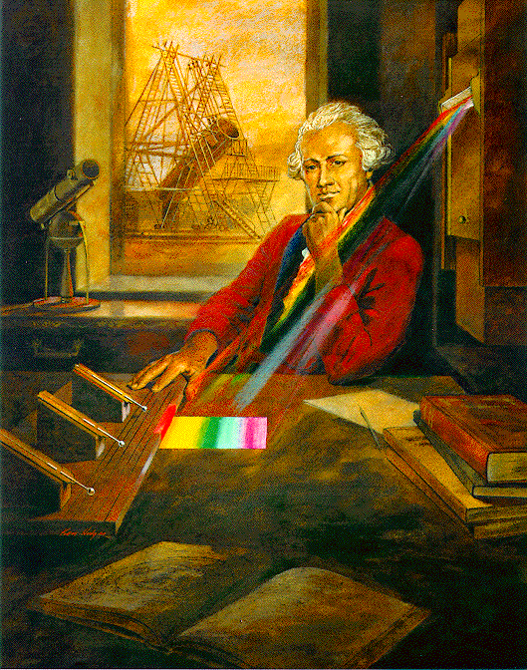
Infrared radiation (IR) is electromagnetic radiation (EMR) at wavelengths up to 1050 nm.
Absorption or emission of IR radiation is selective and its a subject of research of oscillation Spectroscopy. Especially usefull is absorption IR Spectroscopy.
Infrared was discovered in 1800 by astronomer Sir William Herschel, who discovered a type of invisible radiation in the spectrum lower in energy than red light, by means of its effect on a thermometer. Slightly more than half of the total energy from the Sun was eventually found to arrive on Earth in the form of infrared. The balance between absorbed and emitted infrared radiation has a critical effect on Earth's climate.
Herschel’s discovery was important, because for the very first time the invisible (for human eye) radiation was noticed.

Slide 29
IR spectroscopy and Raman Spectroscopy as complementary methods
IR spectroscopy and Raman spectroscopy provides informations on vibrations of molecules.
IR spectroscopy is an absorption spectroscopy.
Raman spectroscopy use the phenomenon of light scattering.
For particles several conditions must be met, to absorb IR radiation. These conditions are called selection rules
---------> lectures

Slide 30
IR spectroscopy and Raman Spectroscopy as complementary methods
Raman Spectroscopy and IR Spectroscopy, provides information about vibrational properties of molecules
Raman Spectroscopy is based on light scattering
IR Spectroscopy is based on absorption
What are the differences?
Symmetric stretching
bending
rocking
wagging
twisting
Antisymmetric stretching
Linear Molecules: (3N - 5) degrees of freedom
Non-Linear molecules: (3N - 6) degrees of freedom

Slide 31
Spektroskopia IR i spektroskopia Ramana jako metody komplementarne
Reguły wyboru dla przejść w spektroskopii IR
1. Fotony promieniowania muszą mieć energię równą różnicy energii wibracyjnych poziomów energetycznych:
hν=ΔE
2. Przejście zachodzi tylko wtedy, gdy kwantowa liczba oscylacji zmienia się o 1,2,3...
Δν=+1 oscylator harmoniczny
Δν=+1, +2, +3,…, oscylator anharmoniczny
3.W trakcie drgania musi nastąpić zmiana momentu dipolowego cząsteczki
Ponad to prawdopodobieństwo pojawienia się tonów podstawowych jest zarówno w molekułach dwu- jak i wieloatomowych proporcjonalne do kwadratu pochodnej momentu dipolowego względem współrzędnej normalnej drgania, a integralny współczynnik absorpcji jest tym większy im bardziej moment dipolowy zmienia się w trakcie drgania.

Slide 32
Spektroskopia IR i spektroskopia Ramana jako metody komplementarne
W przypadku spektroskopii Ramana reguły wyboru są zaś następujące:
1. Różnica energia fotonu padającego i rozproszonego pasuje do różnicy poziomów oscylacyjnych:
hν₀-hν_{R}=ΔE
2. Przejście musi nastąpić tak by kwantowa liczba oscylacji zmieniała się o 1 (dla oscylatora harmonicznego)
czyli Δν=+1 oscylator harmoniczny
Δν=+1, +2, +3,…, oscylator anharmoniczny
3. W trakcie drgania musi nastąpić zmiana polaryzowalności cząsteczki
Mechanizm rozpraszania ramanowskiego można wytłumaczyć w oparciu o teorię polaryzowalności Placzka.
Cząsteczka jest zbiorem ładunków elektrycznych dodatnich i ujemnych. Nośnikami dodatnich są atomowy, ujemnych zaś elektrony walencyjne. Składowa elektryczna promieniowania elektromagnetycznego musi więc z nimi oddziaływać, przez co indukuje w cząsteczce moment dipolowy wyrażony wzorem:
(1)

Slide 33
In order for the vibration to be visible in IR spectroscopy, a change in the permament dipole moment of the molecule must occur during the vibration
In order for the vibration to be visible in Raman spectroscopy, the polarity of the molecule must change during the vibration
PRINCIPLE OF MUTUAL EXCLUSION
For molecules which have inversion center- vibrations active in IR are not active in Raman Spectroscopy and vice versa.
If there is no center of symmetry then some (but not necessarily all) vibrations may be both Raman and IR active.

Slide 34
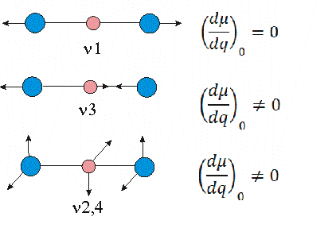
Principle of complementarity on the example of a CO₂ molecule.
The CO₂ molecule does not have a permanent dipole moment, during symmetric stretching vibrations ν1 the position of the centers of gravity does not change, i.e. the dipole moment does not change, vibration ν1 is inactive in IR

Slide 35
Spektroskopia IR i spektroskopia Ramana jako metody komplementarne
Principle of complementarity on the example of a CO₂ molecule.
During the antisymmetric stretching vibration ν3 the position of the center of gravity of the positive charge shifts to one side, and the negative charge to the opposite side, a dipole moment oscillating around zero arises, the vibration ν3 is active in IR.

Slide 36
Spektroskopia IR i spektroskopia Ramana jako metody komplementarne
Principle of complementarity on the example of a CO2 molecule.
In the twice-degenerate bending vibration ν2,4, the centers of gravity of the charges periodically shift in the direction perpendicular to the axis of the highest symmetry and a dipole moment oscillating around zero is created perpendicular to the molecule axis, vibration ν2,4 is active in IR.

Slide 37
IR spectroscopy and Raman Spectroscopy as complementary methods
bending
No change in dipole moment,
therfore IR inactive
There is change in polarisability,
therfore Raman active
The deformation vibrations of CO2
are degenerate and appear at the same
region (666 cm-1)in the IR spectrum of CO2.
There is no change in polarisability,
therefore these vibrations are Raman inactive
There is a change in dipole moment,
Therefore IR active but Raman inactive
IR inactive active active -> dipole moment
Raman active inactive inactive -> polarizability

Slide 38
The Raman shifts in the Raman spectra are identical in value to the position of the absorption peaks in the IR spectra, however their relative intensities differ.
Some peaks may be visible in one spectrum and not the other.
Spectroscopic criterion of binding polarity:
If the intensity of the infrared band increases and in the Raman spectrum it decreases, it means that the chemical bond becomes more polarized (ionic). Conversely, when the intensity of the Raman band differs, it means an increase in covalence.

Slide 39
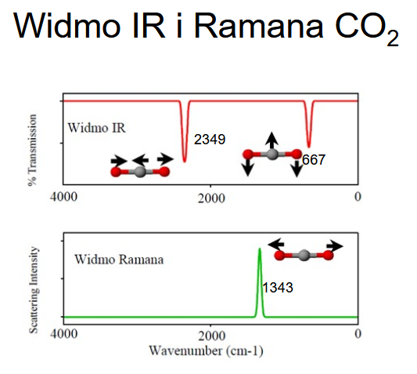

Slide 41
Raman | IR
It is due to the scattering of light by the vibrating molecules. | It is the result of absorption of light by vibrating molecules.
The vibration is Raman active if it causes a change in polarisability | Vibration is IR active if there is change in dipole moment.
The molecule need not possess a permanent dipole moment. | The vibration concerned should have a change in dipole moment due to that vibration.
Water can be used as a solvent. | Water cannot be used due to its intense absorption of IR.
Sample preparation is not very elaborate, it can be in any state | Sample preparation is elaborate Gaseous samples can rarely be used.
Gives an indication of covalent character in the molecule | Gives an indication of ionic character in the molecule.
Cost of instrumentation is very high | Comparatively inexpensive.

Slide 42
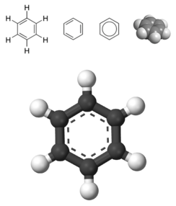
Benzene

Slide 43
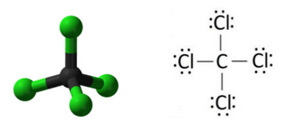
CCl4

Slide 44
Report should contain:
1. Theoretical introduction on the complementarity of Raman spectroscopy and IR spectroscopy
2. Aim and description of the performed experiment.
3. Printouts of Raman and IR spectra recorded.
4. Analysis of recorded Raman and IR spectra.
5. The conclusions of the performed experiment.
6. List of literature.

